Slide 1

Gaming Sports Arena
Level Up Your Game-Sports Arena Website
The Ultimate Destination For Gamers, Esports Teams and Competitive Gaming.
Est. 2026

Slide 2
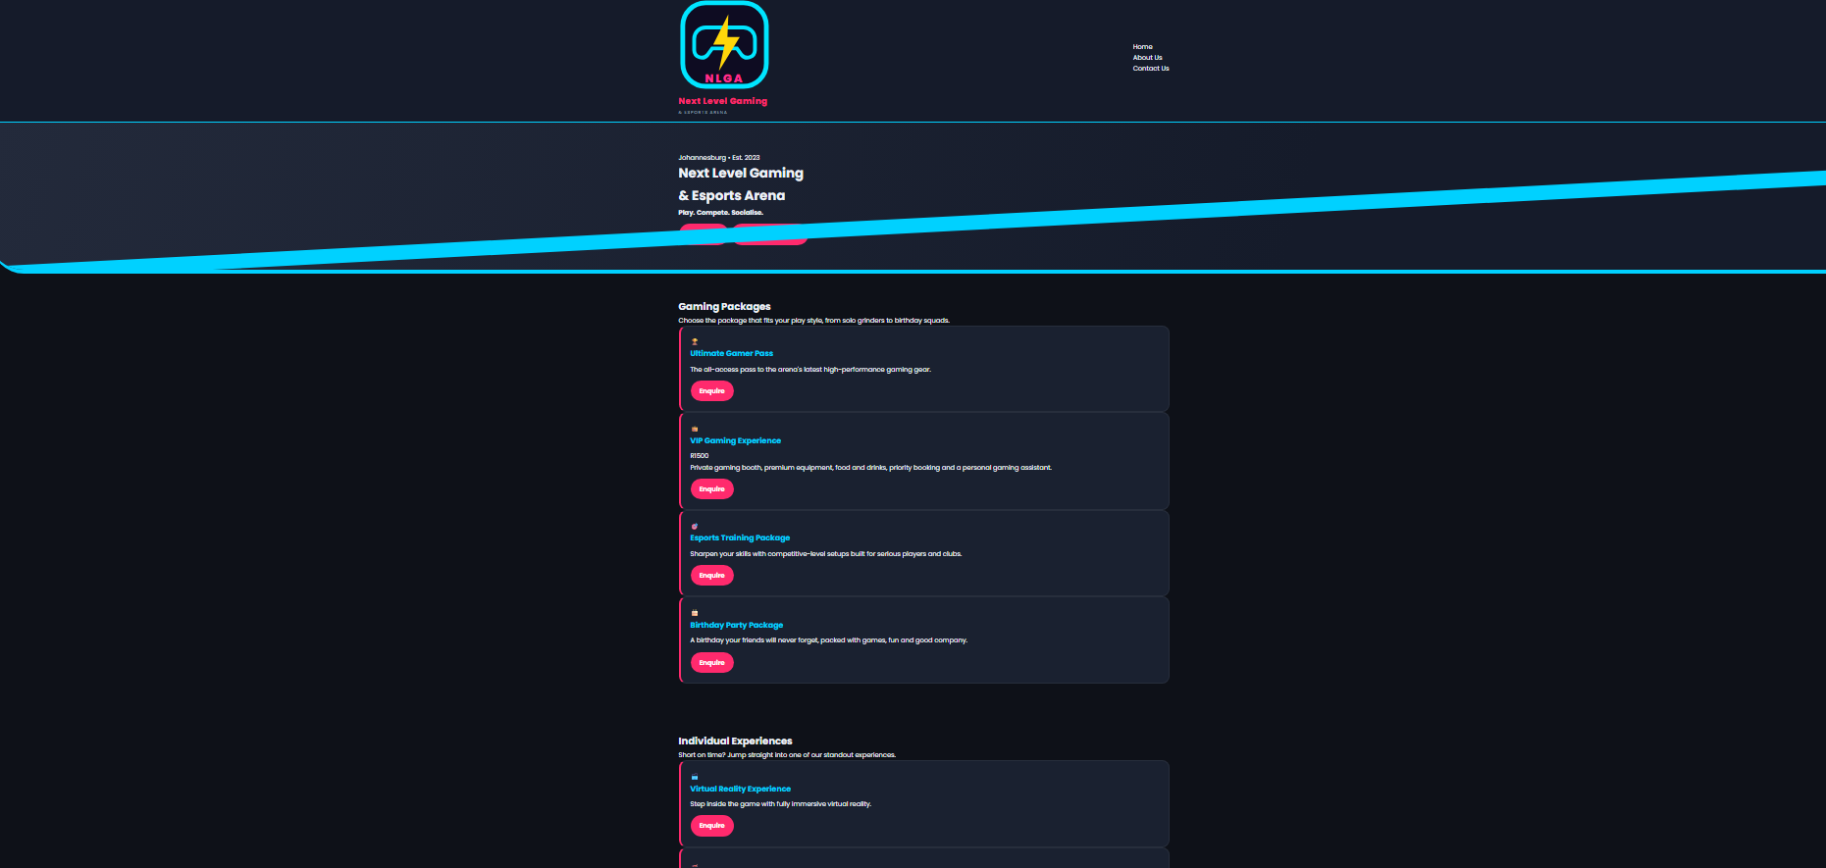
Vision/Mission
Our main goal is to introduce South Africa’s physical and online gaming arena. The country faces noticeable shortage of professional gaming facilities.
To create SA’s premier gaming arena-physical+online
Connect gamers, teams and fans
Host professional tournaments
Provide high end gaming facilities
Build a thriving online booking and community platform

Slide 3
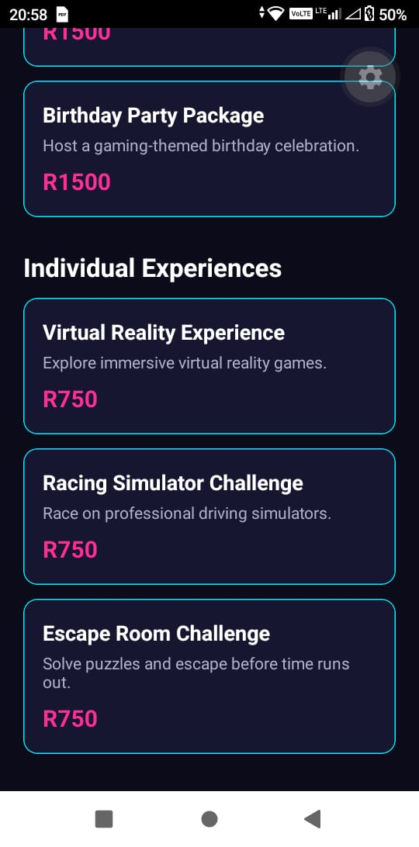
Website Features
How it works:
1
Online Booking: Books consoles and gaming gear in time
2
Live streaming: The website will allow spectators to view live streams of gaming sessions such as tournaments or friendly gaming
3
Shop&Café: Order gear, snacks, drinks onlie
4
Comminity: Find players online, build communities and teams as well as chat with other players online.

Slide 4
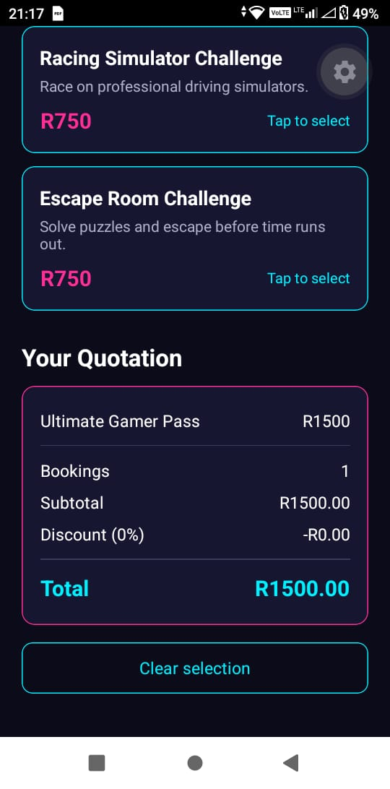
GAMES:WHAT WE HOST?
Our catalogue includes a wide variety of popular games such as:
COD: CALL OF DUTY
FIFA: FC26,FC27
BATTLE ROYALE
FORTNITR
TEKKEN 8
PUBG
NEED FOR SPEED
Our Rig: 50+ High end PC’s RTX 40/ 240Hz /PS5/XBOX X/ VR ZONE/SIM Racing

Slide 5
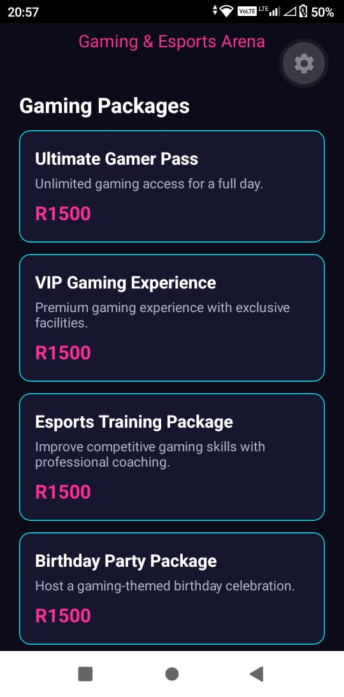
Facilities
ARENA EXPERIENCE
1
MAIN ARENA – 100 seats, stage , big screen.
2
BOOTCAMP ROOMS – Private 5v5 for pro teams.
3
LOUNGE&CAFÉ: Watch live gaming sessions while keeping yourself refreshed and well entertained.

Slide 6

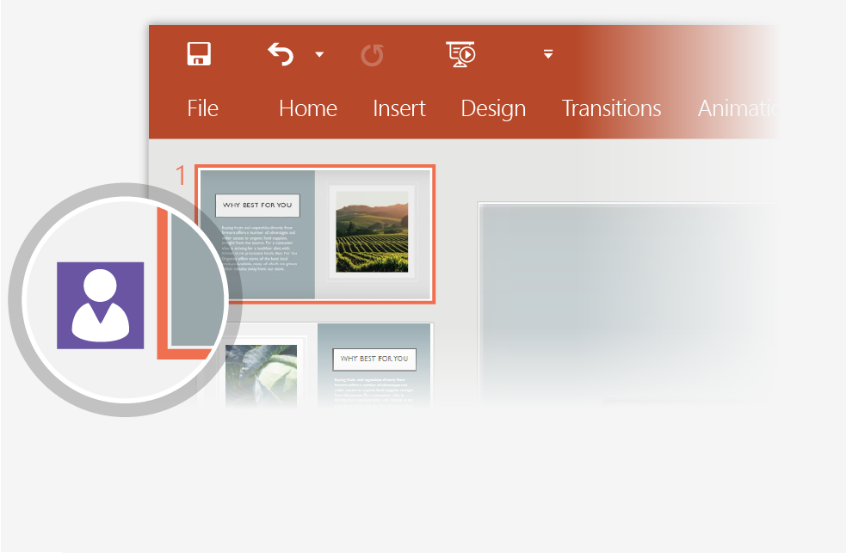

Working together in real time
When you share your presentation with others, you’ll see them working with you at the same time.
How it works:
1
Select Share from above the ribbon, or by using short-key Alt-ZS, to invite people to work with you (You can save to the cloud at this point.)
2
When other people are in the presentation, a marker shows who is on which slide…
3
…and the part of the slide they're editing.

Slide 7



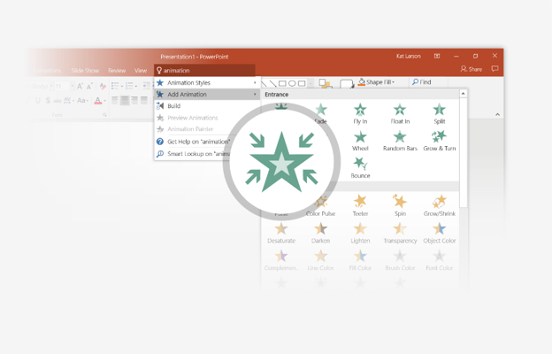
You’re an expert with Tell Me
The Tell Me box finds the right command when you need it,
so you can save time and focus on your work.
Try it:
SELECT ME
1
Select the Robot picture on the right.
2
Type animation in the Tell Me box, and then choose Add Animation.
3
Choose an animation effect, like Zoom, and watch
what happens.

Slide 8
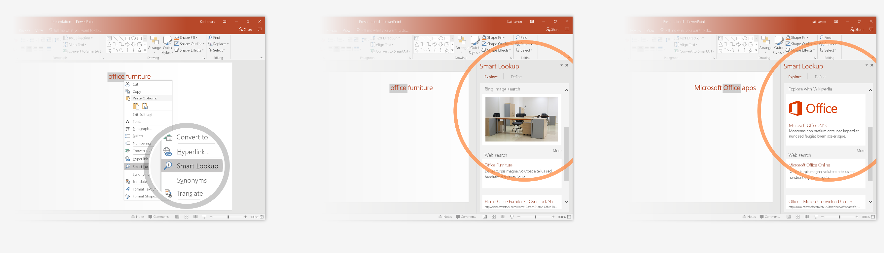
Explore without leaving your slides
Smart Lookup brings research directly in to PowerPoint.
Try it:
1
Right-click in the word office in the following phrase: office furniture
2
Choose Smart Lookup, and notice that results are contextual for that phrase, not Microsoft Office apps.
3
Just for fun, try Smart Lookup again by right-clicking in the word Office in Step 2.

Slide 9

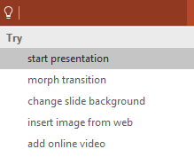

More questions about PowerPoint?
Select the Tell Me button and type what you want to know.
Visit the PowerPoint team blog
Go to free PowerPoint training
Give feedback about this tour
SELECT THE ARROW WHEN IN SLIDE SHOW MODE
Notes:
In Slide Show mode, select the arrows to visit links.

